Slide 1
Leaderboard Competition Creation using Natural Language Processing with disaster tweets dataset
Project Name: HAAAT
Harish, Aryan, Ashwin, Abrielle, Tahir
December 15, 2023

Slide 2
CS410 Project Team (“HAAAT”)
Tahir Bagasrawala (tahirib2)
Ashwin Saxena (ashwins2)
Aryan Gandhi (aryang6)
Abrielle Agron (aa106) (Captain)
Harish Venkata (hkv2)

Slide 3
Leaderboard Competition Results
XX

Slide 4
Dataset

Slide 5
Dataset
Where did we get the data set from?
Kaggle’s Natural Language Processing with Disaster Tweets.
What are we predicting?
We’re predicting whether a given tweet is about a real disaster (1) or not (0).
What files are we using?
Training set: train.csv
Test set: test.csv
Sample submission file: sample_submission.csv
What columns does the file have?
id - a unique identifier for each tweet
text - the text of the tweet
location - the location the tweet was sent from (may be blank)
keyword - a particular keyword from the tweet (may be blank)
target - in train.csv only, this denotes whether a tweet is about a real disaster (1) or not (0)

Slide 6
11 NLP Models Evaluated

Slide 7
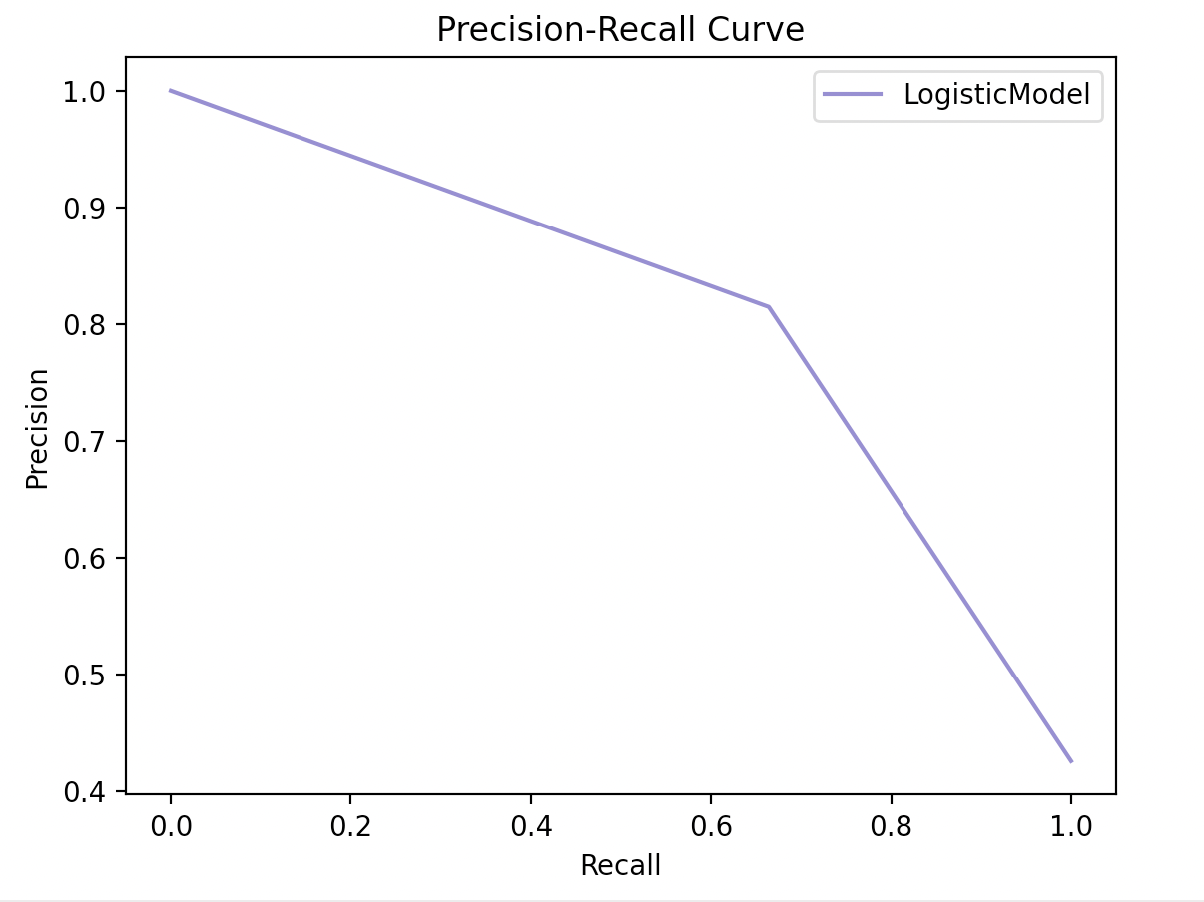
Logistic Model - baseline
This model (also known as logit or MaxEnt) is a popular for classification problems and is our baseline for this project
Key Learnings:
What hyperparameters worked well? Why?
Where the model did well?
Where the model did not?
Results for LogisticModel: {'accuracy': 0.7925147734734077, 'precision': 0.8147448015122873, 'recall': 0.6640986132511556, 'f1_score': 0.731748726655348}
Elapsed: 0.0932 seconds

Slide 8
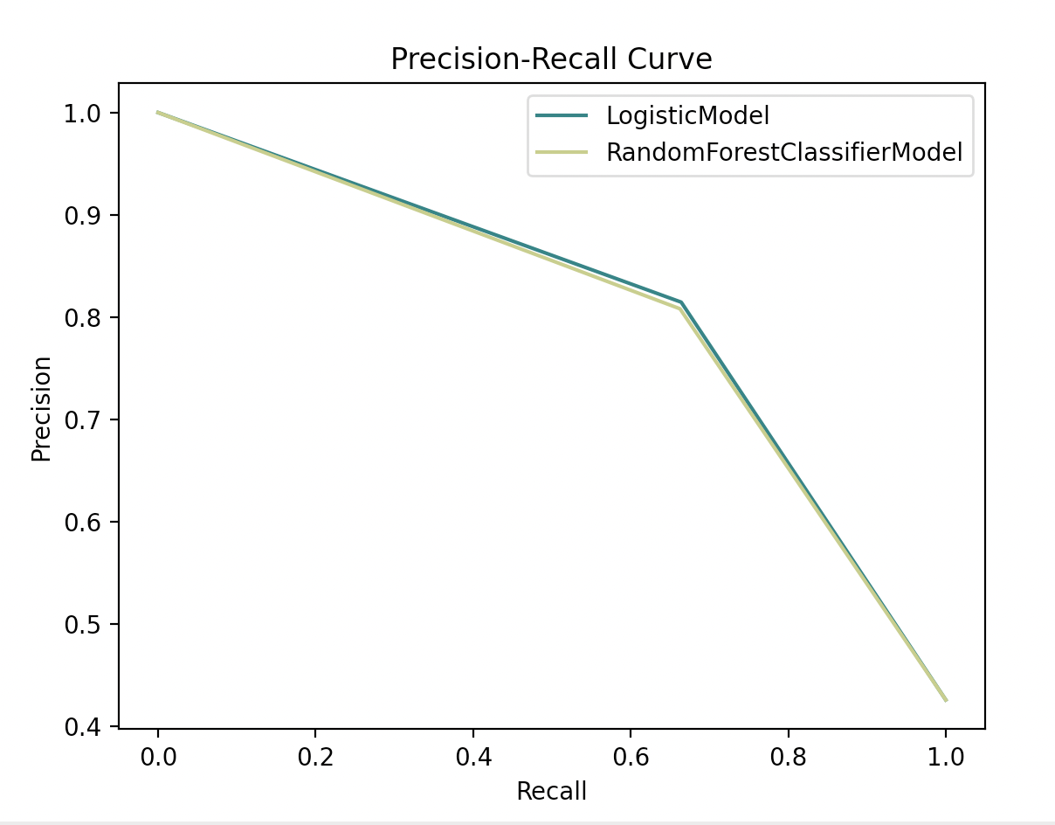
Random Forest Classifier
This model is a meta estimator that fits several decision tree classifiers on various sub-samples of the dataset and uses averaging to improve the predictive accuracy and control over-fitting.
Key Learnings:
What hyperparameters worked well? Why?
Where the model did well?
Where the model did not?
Results for LogisticModel: {'accuracy': 0.7925147734734077, 'precision': 0.8147448015122873, 'recall': 0.6640986132511556, 'f1_score': 0.731748726655348}
Elapsed: 0.089 seconds
Results for RandomForestClassifierModel: {'accuracy': 0.7892317793827971, 'precision': 0.8082706766917294, 'recall': 0.662557781201849, 'f1_score': 0.7281964436917866}
Elapsed: 13.5767 seconds

Slide 9
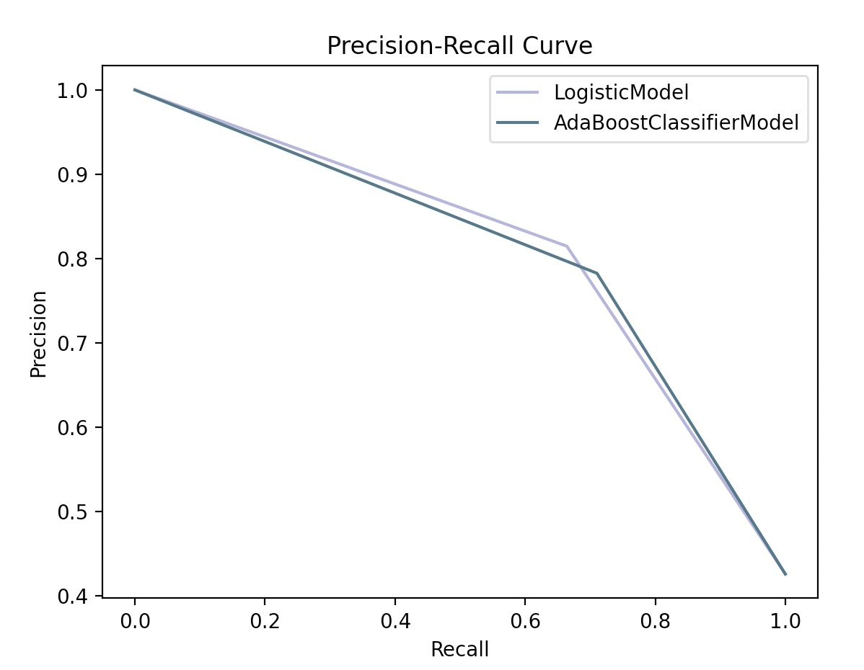
AdaBoost Classifier
This model is a meta-estimator that begins by fitting a classifier on the original dataset and then fits additional copies of the classifier on the same dataset but where the weights of incorrectly classified instances are adjusted such that subsequent classifiers focus more on difficult cases.
Key Learnings:
What hyperparameters worked well? Why?
Where the model did well?
Where the model did not?
Results for LogisticModel: {'accuracy': 0.7925147734734077, 'precision': 0.8147448015122873, 'recall': 0.6640986132511556, 'f1_score': 0.731748726655348}
Elapsed: 0.0881 seconds
Results for AdaBoostClassifierModel: {'accuracy': 0.7925147734734077, 'precision': 0.7826825127334465, 'recall': 0.7103235747303543, 'f1_score': 0.7447495961227785}
Elapsed: 780.157 seconds

Slide 10
Decision Tree Classifier
This model predicts the value of a target variable by learning simple decision rules inferred from the data features. A tree can be seen as a piecewise constant approximation.
Key Learnings:
What hyperparameters worked well? Why?
Where the model did well?
Where the model did not?
Precision Recall Plot
Results for DecisionTreeClassifierModel: {'accuracy': 0.6710439921208142, 'precision': 0.6428571428571429, 'recall': 0.5130970724191063, 'f1_score': 0.570694087403599}
Elapsed: 0.5596 seconds

Slide 11
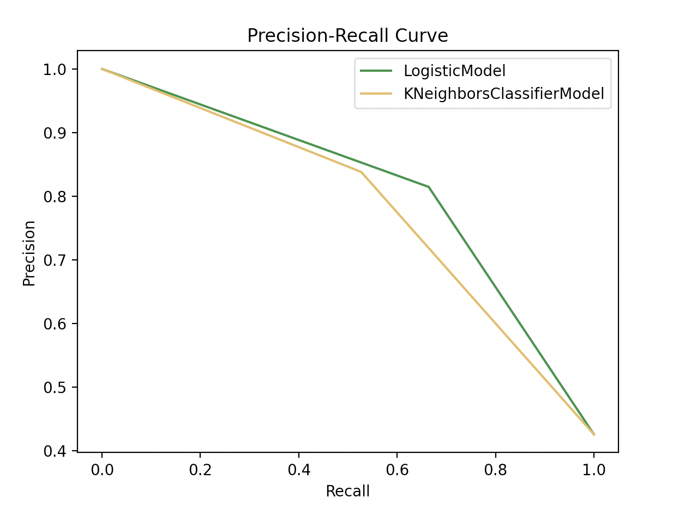
K-Neighbors Classifier
This model implements the k-nearest neighbor's vote.
Key Learnings:
What hyperparameters worked well? Why?
Where the model did well?
Where the model did not?
Results for LogisticModel: {'accuracy': 0.7925147734734077, 'precision': 0.8147448015122873, 'recall': 0.6640986132511556, 'f1_score': 0.731748726655348}
Elapsed: 0.0894 seconds
Results for KNeighborsClassifierModel: {'accuracy': 0.7550886408404465, 'precision': 0.8382352941176471, 'recall': 0.5269645608628659, 'f1_score': 0.6471144749290444}
Elapsed: 0.3079 seconds

Slide 12
K-Means
This model clusters data by trying to separate samples in n groups of equal variance, minimizing a criterion known as the inertia or within-cluster sum-of-squares.
Key Learnings:
What hyperparameters worked well? Why?
Where the model did well?
Where the model did not?
Precision Recall Plot

Slide 13
Latent Dirichlet Allocation (LDA)
This model is a generative probabilistic model for collections of discrete dataset such as text corpora. It is also a topic model that is used for discovering abstract topics from a collection of documents.
Key Learnings:
What hyperparameters worked well? Why?
Where the model did well?
Where the model did not?
Precision Recall Plot
Classification Report
 | Precision | Recall | F1-score | Support
Accuracy
Macro avg.
Weighted avg.

Slide 14
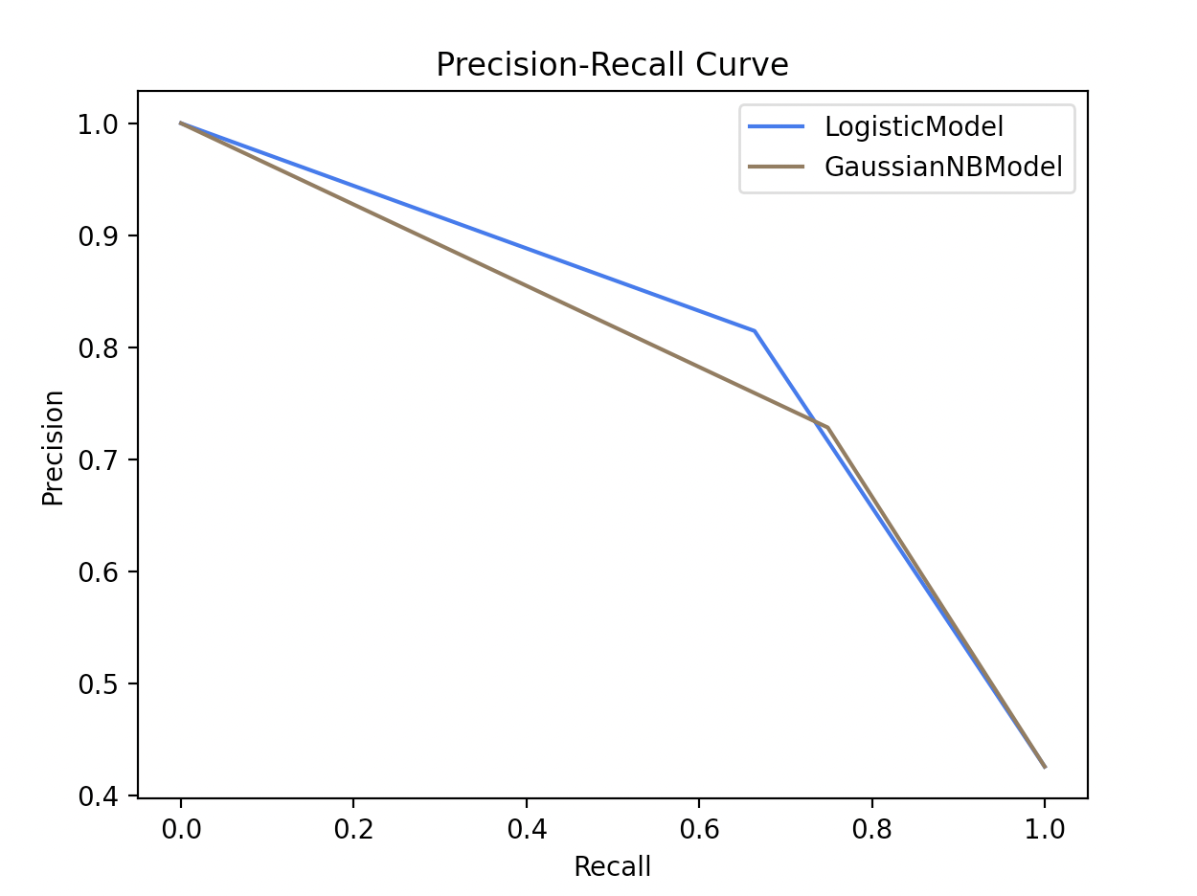
Naïve Bayes
This model has a set of supervised learning algorithms based on applying Bayes’ theorem with the “naive” assumption of conditional independence between every pair of features given the value of the class variable
Key Learnings:
What hyperparameters worked well? Why?
Where the model did well?
Where the model did not?
Results for LogisticModel: {'accuracy': 0.7925147734734077, 'precision': 0.8147448015122873, 'recall': 0.6640986132511556, 'f1_score': 0.731748726655348}
Elapsed: 0.0872 seconds
Results for GaussianNBModel: {'accuracy': 0.7741300065659882, 'precision': 0.7286356821589205, 'recall': 0.74884437596302, 'f1_score': 0.7386018237082066}
Elapsed: 0.4472 seconds

Slide 15
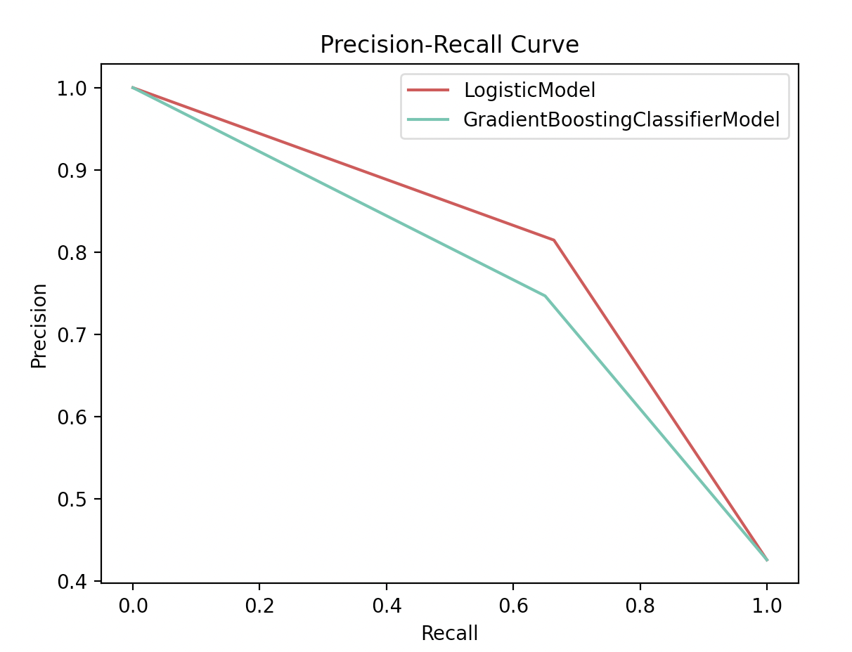
Gradient Boosting Classifier
This model builds an additive model in a forward stage-wise fashion; it allows for the optimization of arbitrary differentiable loss functions.
Key Learnings:
What hyperparameters worked well? Why?
Where the model did well?
Where the model did not?
Results for LogisticModel: {'accuracy': 0.7925147734734077, 'precision': 0.8147448015122873, 'recall': 0.6640986132511556, 'f1_score': 0.731748726655348}
Elapsed: 0.0894 seconds
Results for GradientBoostingClassifierModel: {'accuracy': 0.7570584372948129, 'precision': 0.7469026548672566, 'recall': 0.650231124807396, 'f1_score': 0.6952224052718287}
Elapsed: 1.014 seconds

Slide 16
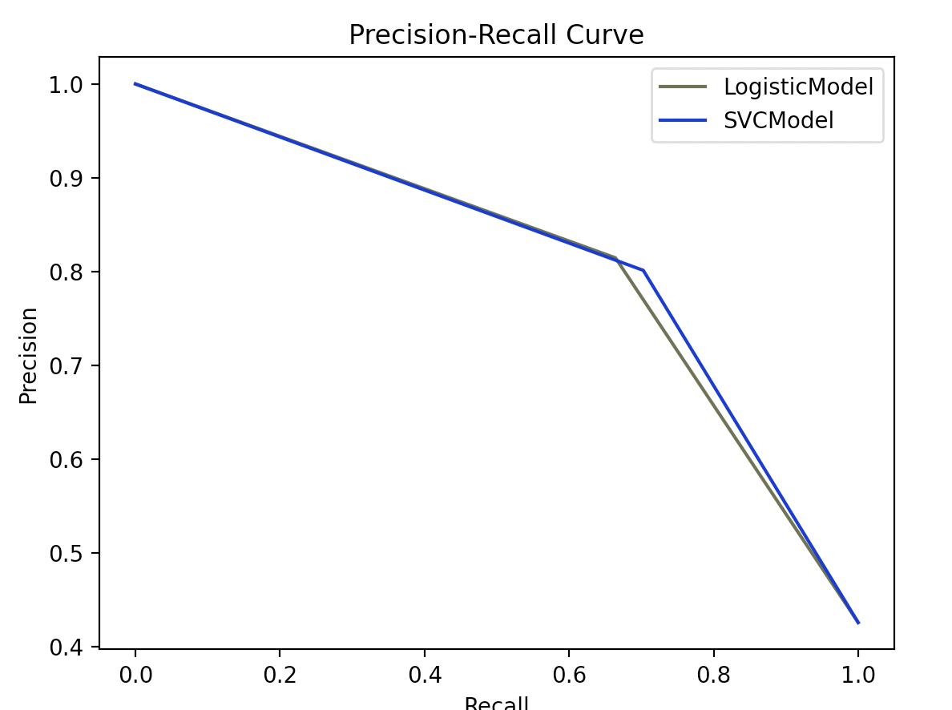
Support Vector Classifier (SVC)
This model is a linear support vector classification model.
Key Learnings:
What hyperparameters worked well? Why?
Where the model did well?
Where the model did not?
Results for LogisticModel: {'accuracy': 0.7925147734734077, 'precision': 0.8147448015122873, 'recall': 0.6640986132511556, 'f1_score': 0.731748726655348}
Elapsed: 0.0891 seconds
Results for SVCModel: {'accuracy': 0.799080761654629, 'precision': 0.8014059753954306, 'recall': 0.7026194144838213, 'f1_score': 0.7487684729064038}
Elapsed: 0.1691 seconds

Slide 17
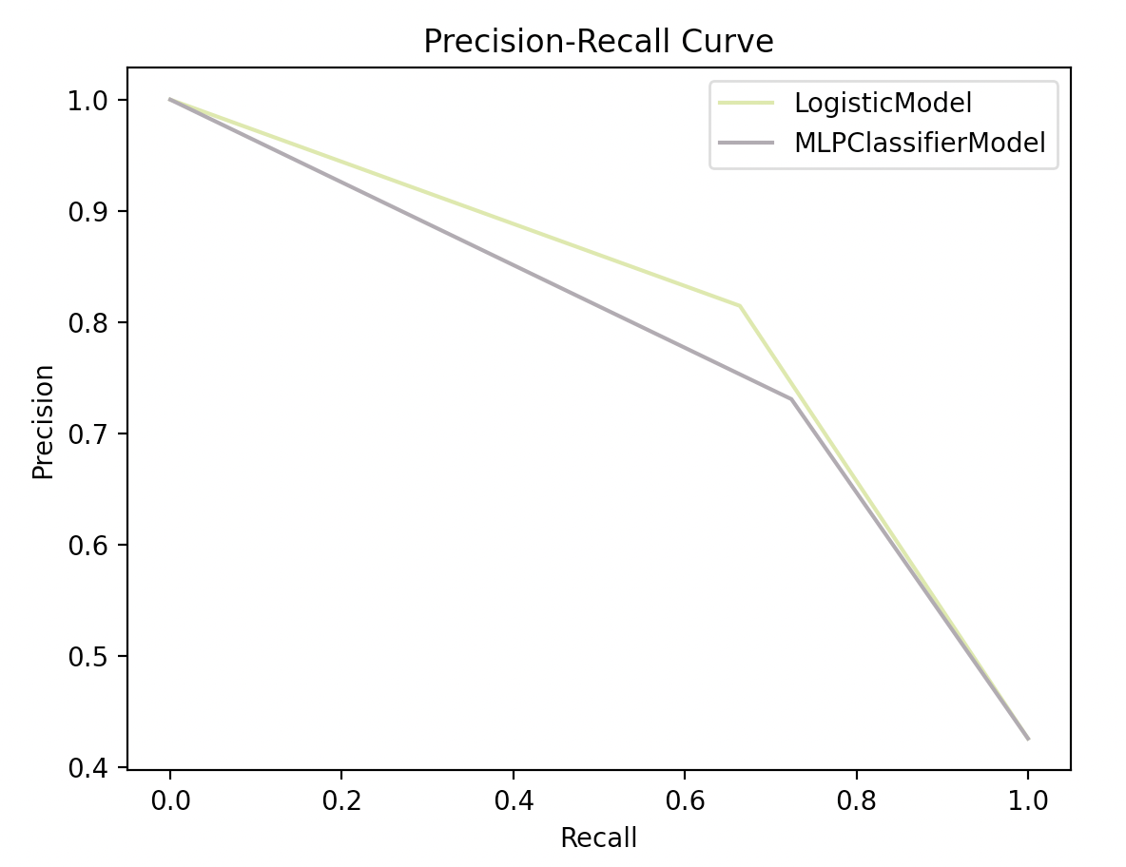
Multi-layer Perceptron (MLP) Classifier
This model optimizes the log-loss function using LBFGS or stochastic gradient descent.
Key Learnings:
What hyperparameters worked well? Why?
Where the model did well?
Where the model did not?
Results for LogisticModel: {'accuracy': 0.7925147734734077, 'precision': 0.8147448015122873, 'recall': 0.6640986132511556, 'f1_score': 0.731748726655348}
Elapsed: 0.09 seconds
Results for MLPClassifierModel: {'accuracy': 0.7688772160210111, 'precision': 0.7309486780715396, 'recall': 0.724191063174114, 'f1_score': 0.7275541795665633}

Slide 18
Source Code

Slide 19
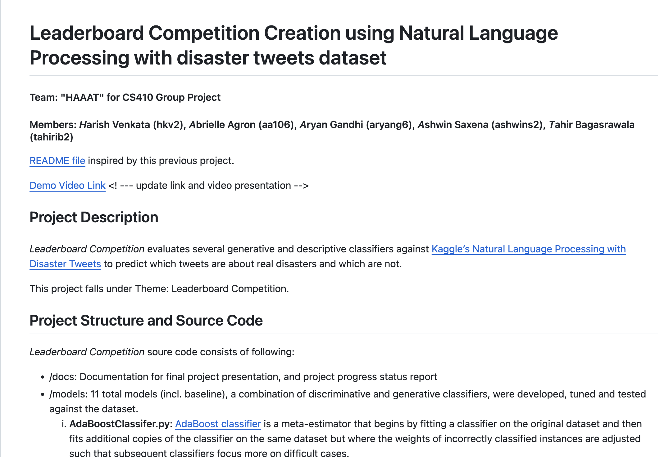
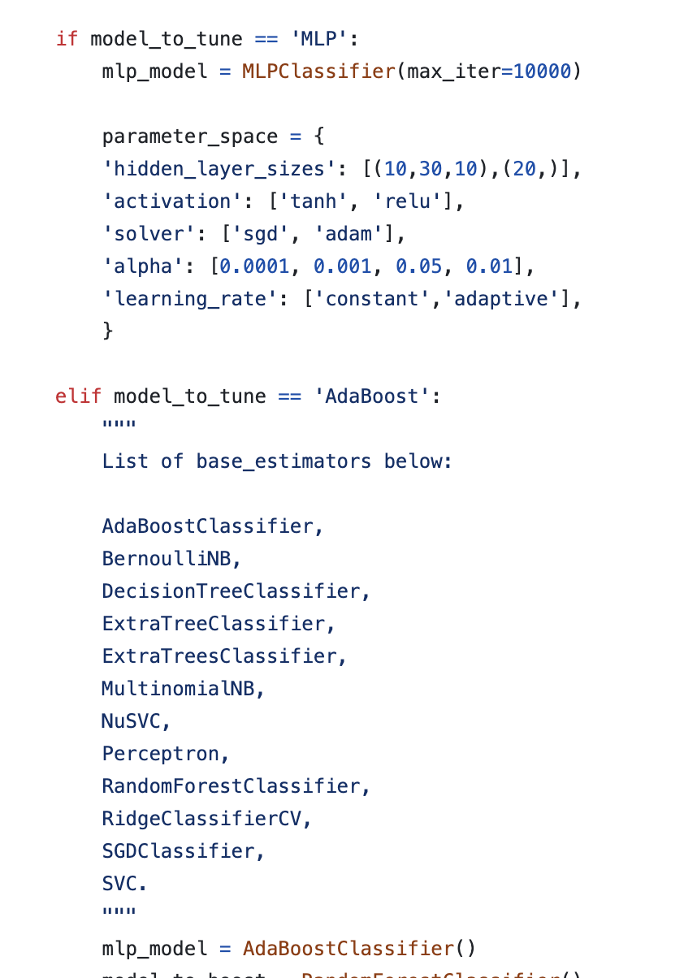
Source Code
https://github.com/tahirbags/cs410_project_public/tree/main

Slide 20
Video Presentation

Slide 21
Video Presentation
LINK OF VIDEO
IMAGE OF VIDEO

